Slide 1
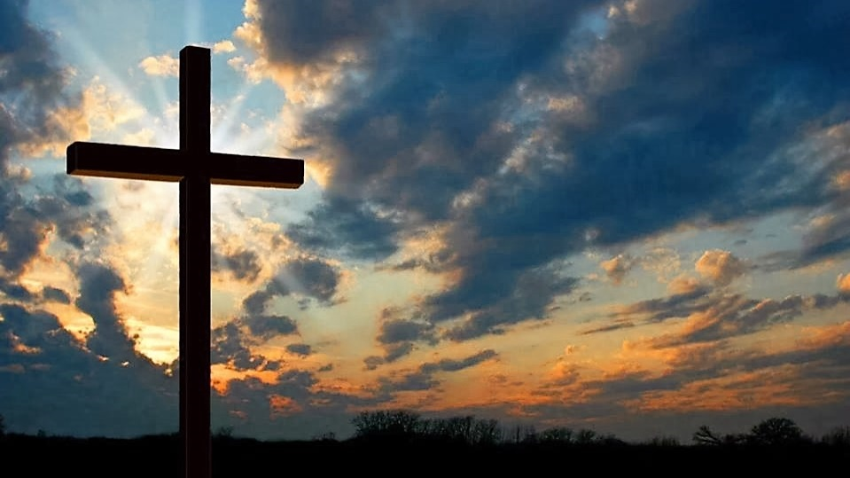
Sunday Worship
Faith Baptist Church May 10, 2020

Slide 3
This is the day red book #218
This is the day,
this is the day,
That the Lord has made, that the Lord has made.

Slide 4
This is the day red book #218
We will rejoice,
we will rejoice,
and be glad in it,
and be glad in it.

Slide 5
This is the day red book #218
This is the day that the Lord has made,
We will rejoice and be glad in it.

Slide 6
This is the day red book #218
This is the day,
this is the day,
that the Lord has made.
CCLI #2222135

Slide 8
Lamentations 3:22-23 Through the LORD's mercies, we are not consumed, because His compassions fail not. They are new every morning; Great is Your faithfulness.

Slide 10
I will sing of the mercies of the lord chorus #180
I will sing of the mercies
of the Lord forever
I will sing, I will sing

Slide 11
I will sing of the mercies of the lord chorus #180
I will sing of the mercies
of the Lord forever
I will sing of the mercies
of the Lord.

Slide 12
I will sing of the mercies of the lord chorus #180
With my mouth
will I make known
Thy faithfulness,
Thy faithfulness;

Slide 13
I will sing of the mercies of the lord chorus #180
With my mouth
will I make known
Thy faithfulness
to all generations

Slide 14
I will sing of the mercies of the lord chorus #180
I will sing of the mercies
of the Lord forever
I will sing, I will sing

Slide 15
I will sing of the mercies of the lord chorus #180
I will sing of the mercies
of the Lord forever
I will sing of the mercies
of the Lord.
CCLI #2222135

Slide 17
Matthew 6:34 (NKJV)
Therefore do not worry about tomorrow, for tomorrow will worry about its own things. Sufficient for the day its own trouble.

Slide 19
Day by day #448 verse 1
Day by day and with each passing moment,
Strength I find to meet my trials here;

Slide 20
Day by day #448 verse 1
Trusting in my Father’s wise bestowment,
I’ve no cause for worry or for fear.

Slide 21
Day by day #448 verse 1
He whose heart is kind beyond all measure
Gives unto each day what he deems best –

Slide 22
Day by day #448 verse 1
Lovingly, it’s part of
pain and pleasure,
Mingling toil with
peace and rest.

Slide 23
Day by day #448 verse 2
Every day the Lord
Himself is near me
With a special mercy
for each hour;

Slide 24
Day by day #448 verse 2
All my cares He fain
would bear and cheer
me, He whose name
is Counselor and Power.

Slide 25
Day by day #448 verse 2
The protection of
His child and treasure
Is a charge that
on Himself He laid;

Slide 26
Day by day #448 verse 2
“As thy days, thy strength
shall be in measure,”
This the pledge
to me He made

Slide 27
Day by day #448 verse 3
Help me then in
every tribulation
So to trust Thy
promises, O Lord

Slide 28
Day by day #448 verse 3
That I lose not Faith’s
sweet consolation
Offered me within
Thy holy Word.

Slide 29
Day by day #448 verse 3
Help me Lord, when
toil and trouble meeting,
E’er to take, as from
a father’s hand,

Slide 30
Day by day #448 verse 3
One by one, the days,
the moments fleeting,
Till I reach the
promised land.
CCLI #2222135

Slide 32
2 Corinthians 12:9 (NKJV)
“My grace is sufficient for you, for my strength is made perfect in weakness.”

Slide 34
Lamentations 3:22-23 Through the LORD's mercies we are not consumed, because His compassions fail not. They are new every morning; Great is Your faithfulness

Slide 36
Great is thy faithfulness #109 verse 1
Great is Thy faithfulness,
O God my Father !
There is no shadow
Of turning with Thee;

Slide 37
Great is thy faithfulness #109 verse 1
Thou changest not,
Thy compassions they fail not;
As Thou hast been
Thou forever wilt be.

Slide 38
Great is thy faithfulness #109 Chorus
Great is Thy faithfulness !
Great is Thy faithfulness !
Morning by morning
New mercies I see;

Slide 39
Great is thy faithfulness #109 Chorus
All I have needed
Thy hand hath provided –
Great is Thy Faithfulness,
Lord, unto me!

Slide 40
Great is thy faithfulness #109 verse 2
Summer and winter, and
Spring-time and harvest,
Sun, moon, and stars
In their courses above

Slide 41
Great is thy faithfulness #109 verse 2
Join with all nature
In manifold witness
To Thy great faithfulness,
Mercy, and love.

Slide 42
Great is thy faithfulness #109 Chorus
Great is Thy faithfulness !
Great is Thy faithfulness !
Morning by morning
New mercies I see;

Slide 43
Great is thy faithfulness #109 Chorus
All I have needed
Thy hand hath provided –
Great is Thy Faithfulness,
Lord, unto me!

Slide 44
Great is thy faithfulness #109 verse 3
Pardon for sin and a
Peace that endureth,
Thine own dear presence
To cheer and to guide;

Slide 45
Great is thy faithfulness #109 verse 3
Strength for today And bright hope for tomorrow,
Blessings all mine, With ten thousand beside !

Slide 46
Great is thy faithfulness #109 Chorus
Great is Thy faithfulness !
Great is Thy faithfulness !
Morning by morning
New mercies I see;

Slide 47
Great is thy faithfulness #109 Chorus
All I have needed
Thy hand hath provided –
Great is Thy Faithfulness,
Lord, unto me!
CCLI #2222135

Slide 49
For god so loved the world #602 chorus
For God so loved the world
He gave His only Son
To die on Calv’ry’s tree,
From sin to set me free;

Slide 50
For god so loved the world #602 chorus
Some day He’s coming back,
What glory that will be !
Wonderful His love to me.

Slide 51
For god so loved the world #602 chorus
For God so loved the world
He gave His only Son
To die on Calv’ry’s tree,
From sin to set me free;

Slide 52
For god so loved the world #602 chorus
Some day He’s coming back,
What glory that will be !
Wonderful His love to me.

